Slide 1
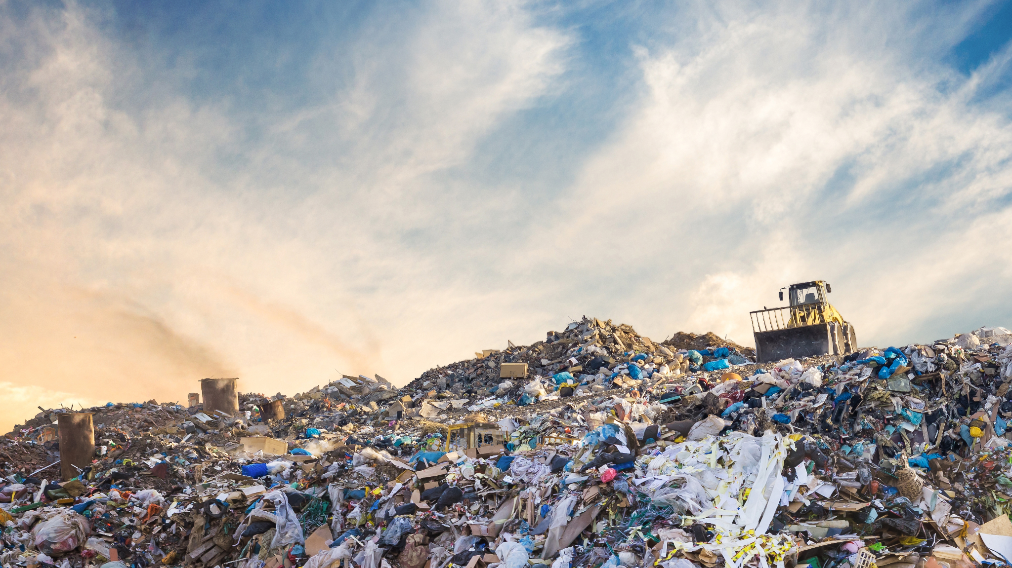
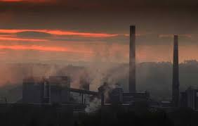

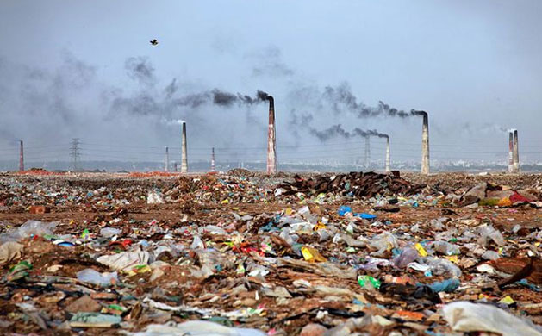
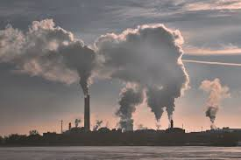
GLOBAL AIR POLLUTION ANALYSIS
INTRO
OVERVIEW
DATA COLLECTION & PROCESSING
DATA VISUALIZATIONS
CORRELATION ANALYSIS
KEY TAKEAWAYS
CONCLUSIONS
An Interactive Data Exploration
Project 1 Group 3
Notes:
Hello everyone. Team 3 here with Anna, Caleb, Diana, Kanchan, and Michael presenting an analysis of Global Air Pollution. Our objective was to analyze, forecast, and visualize air pollution trends using real-time and historical data from OpenWeather’s API.

Slide 2
PROJECT OVERVIEW
INTRO
OVERVIEW
DATA COLLECTION & PROCESSING
DATA
SOURCES
KEY
POLLUTANTS
METHOD-
OLOGY
DATA VISUALIZATIONS
OBJECTIVE
CORRELATION ANALYSIS
KEY TAKEAWAYS
Analyze air pollution levels across major global cities using open-source data.
OpenWeather API, Population Data.
SO2, NO2, PM10, PM2.5, O3, CO.
Data extraction, cleaning, visualization, and correlation analysis.
CONCLUSIONS
Notes:
Kanchan

Slide 3
KEY POLLUTANTS
ANALYZED
INTRO
OVERVIEW
DATA COLLECTION & PROCESSING
SULFUR DIOXIDE
NITROGEN DIOXIDE
PARTICULATE MATTER
≤10 µm
PARTICULATE MATTER
≤2.5 µm
OZONE
CARBON MONOXIDE
SO2
NO2
PM10
PM2.5
O3
CO
DATA VISUALIZATIONS
Source: Burning fossil fuels (coal, oil, and gas), industrial processes, volcanic eruptions.
Effects: Irritates the respiratory system, causing coughing and shortness of breath.
Contributes to the formation of **fine particulate matter (PM2.5)**, worsening air pollution.
Source: Vehicle emissions, power plants, industrial processes.
Effects: Causes inflammation of the airways, leading to respiratory diseases like asthma.
Contributes to ground-level ozone (O₃) formation, a major component of smog.
Leads to acid rain, harming plants, water bodies, and infrastructure.
Source: Dust, construction activities, burning of fossil fuels, agriculture, wildfires.
Effects: Can be inhaled, causing irritation of the eyes, nose, and throat.
Long-term exposure increases the risk of cardiovascular diseases and respiratory conditions.
Source: Vehicle emissions, industrial combustion, wildfires, residential heating.
Effects: More dangerous than PM10 because the smaller particles can penetrate deep into the lungs and enter the bloodstream.
Leads to premature deaths, especially in vulnerable populations.
Source: Formed when NO₂ reacts with volatile organic compounds (VOCs) in sunlight (secondary pollutant).
Effects: Causes ground-level smog, leading to breathing difficulties and lung irritation.
Damages crops and vegetation, reducing agricultural yields.
Source: Incomplete combustion of fuels (vehicle emissions, burning wood, gas stoves, industrial processes).
Effects: Reduces oxygen transport in the blood, leading to dizziness, confusion, and even death at high levels.
Causes cardiovascular and neurological problems with prolonged exposure.
CORRELATION ANALYSIS
KEY TAKEAWAYS
CONCLUSIONS
Notes:
Anna

Slide 4

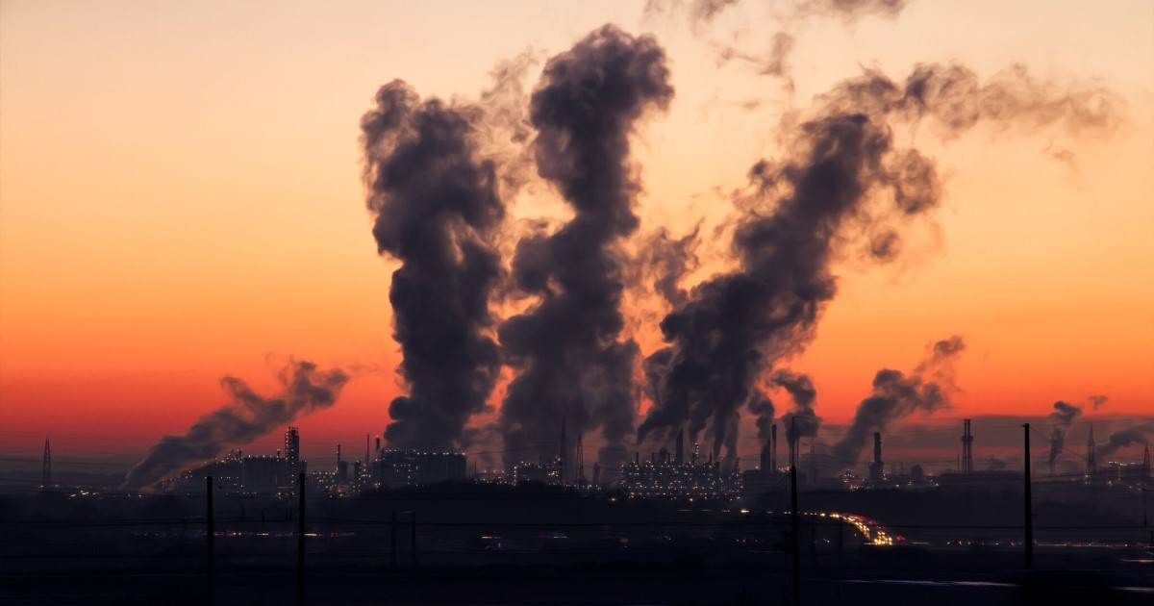
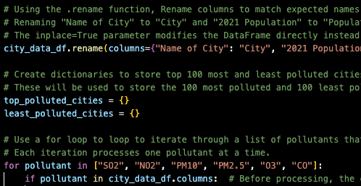
DATA
COLLECTION
APIS USED
INTRO
OpenWeather API for pollution levels.
One Call API 3.0 is a weather service that allows the retrieval of current, historical, short-term and long-term forecasted weather data and severe weather alerts and weather overview.
OVERVIEW
PROCESSING
DATA COLLECTION & PROCESSING
CITY DATASET
Top 1,000 most populated cities.
DATA VISUALIZATIONS
DATA CLEANING
Renaming columns, handling missing values, ensuring data consistency.
CORRELATION ANALYSIS
KEY TAKEAWAYS
CONCLUSIONS
View More: Repository (LINK)
Notes:
Caleb

Slide 5
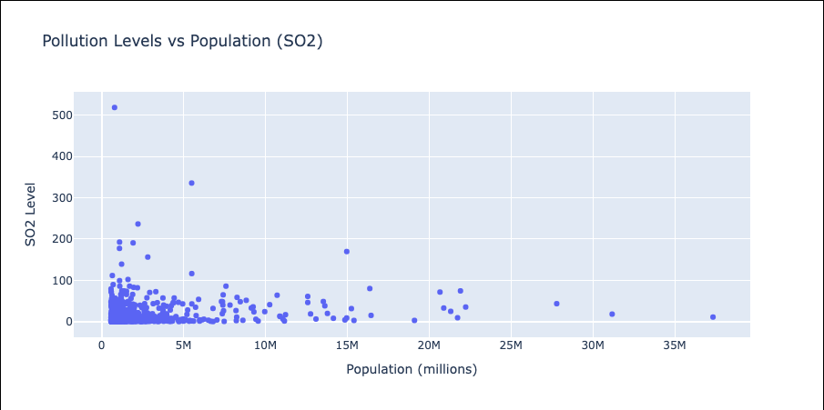
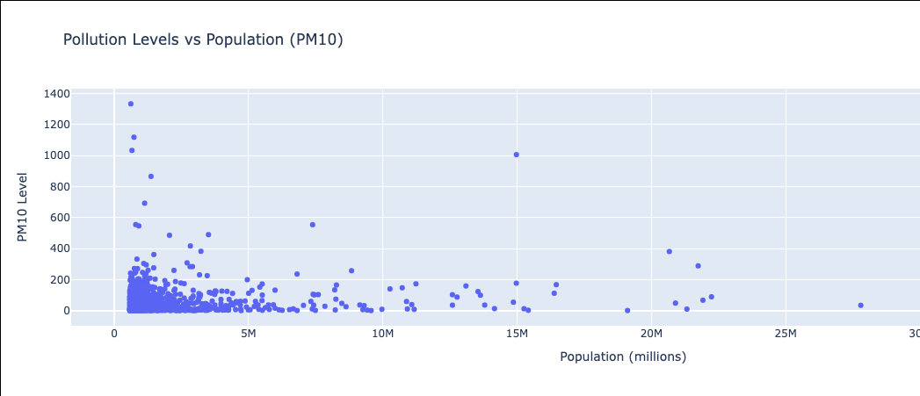
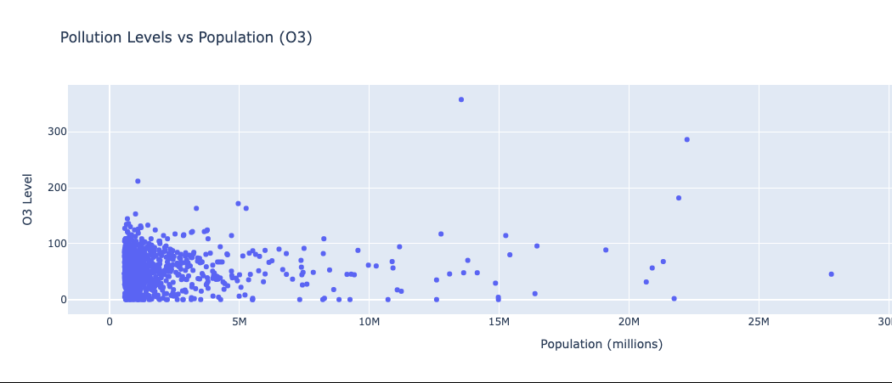
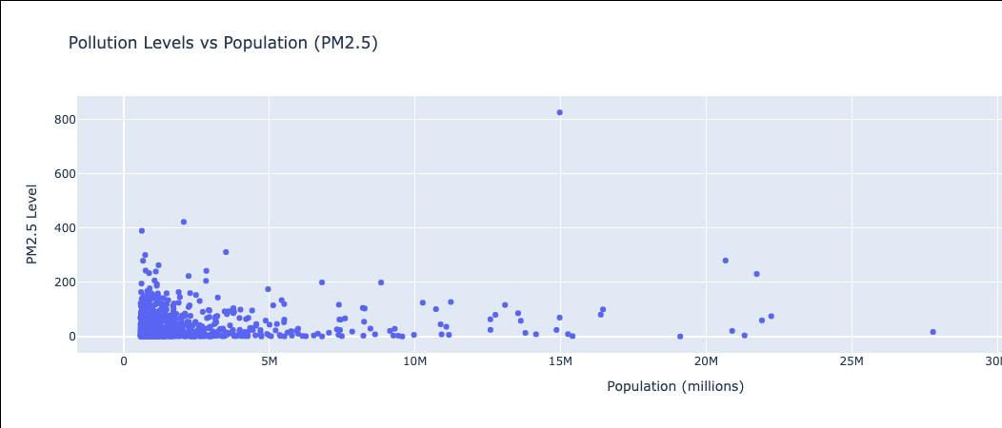
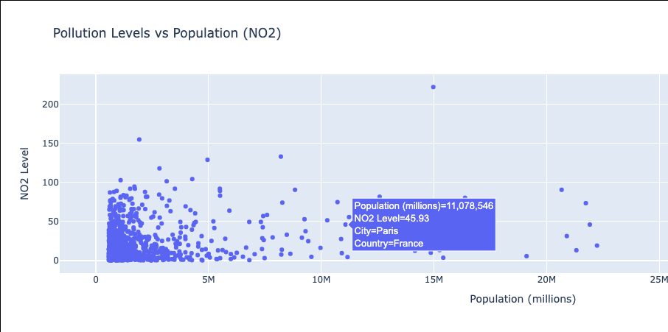
DATA VISUALIZATIONS
INTRO
OVERVIEW
Pollution Levels vs. Population
KEY FINDINGS
DATA COLLECTION & PROCESSING
A scatter plot gives us insight into population against key pollutants:
We expected to see a strong correlation between population and pollution and were shocked to find that this correlation was very weak across our assessed pollutants
This might indicate that high pollutant levels exist near large populations but perhaps not directly within
Further analysis needed to perhaps analyze a correlation between population growth and pollution
DATA VISUALIZATI-ONS
CORRELATION ANALYSIS
KEY TAKEAWAYS
CONCLUSIONS
Notes:
Mike

Slide 6
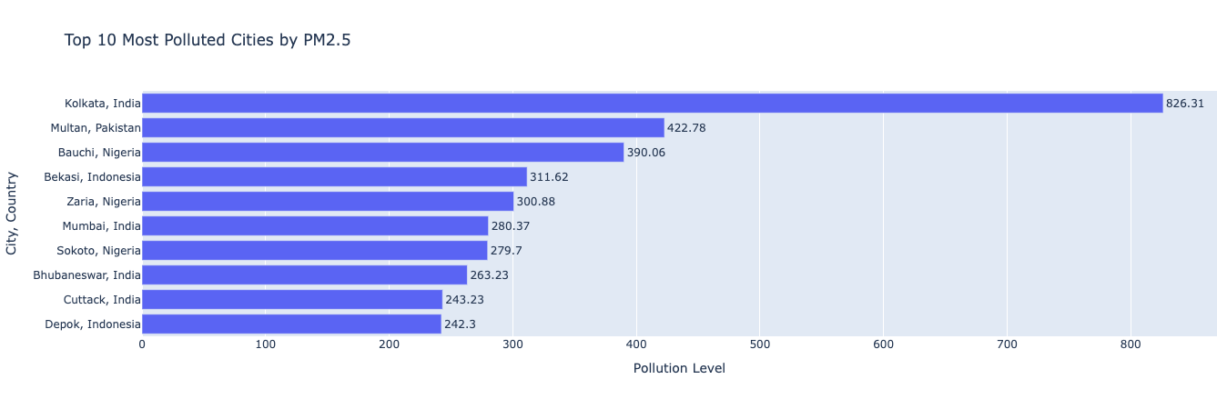
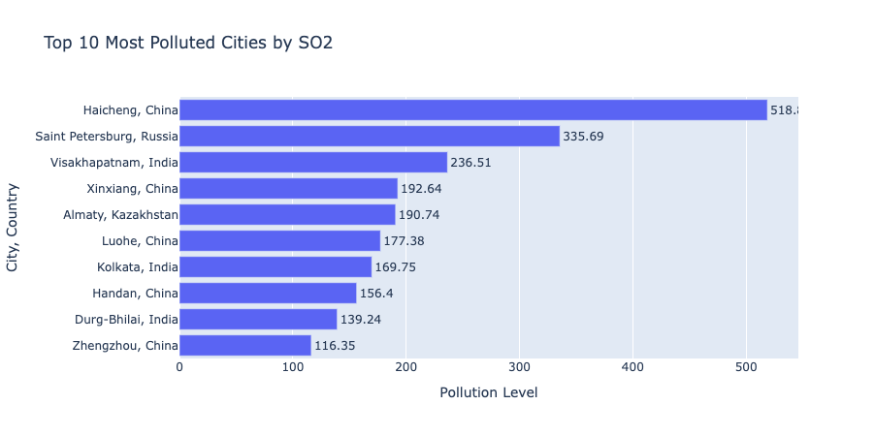
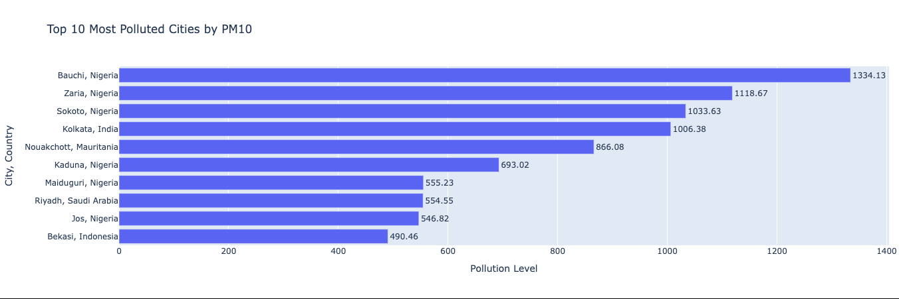
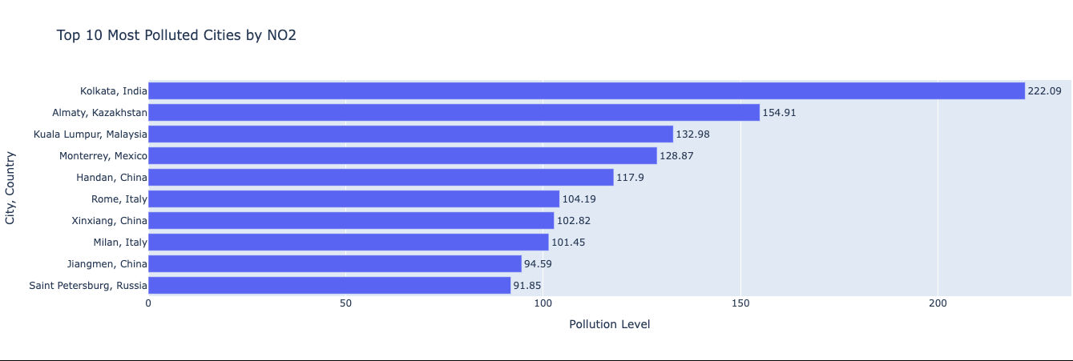
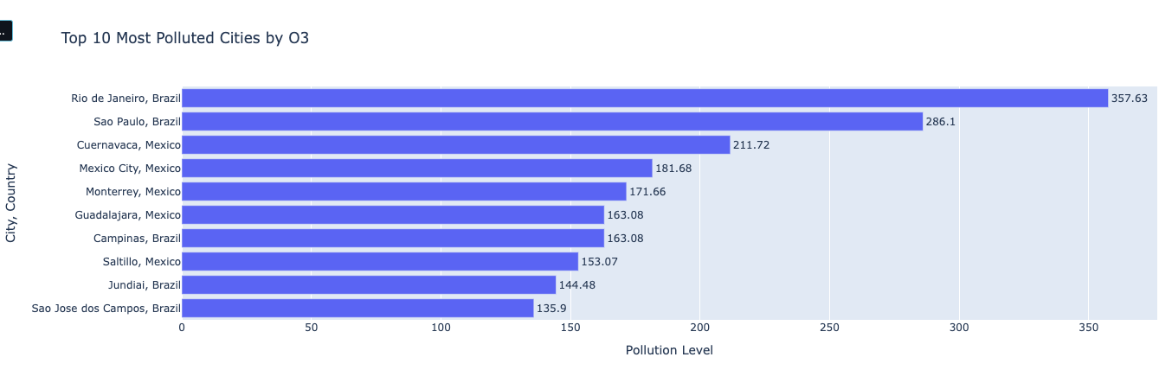
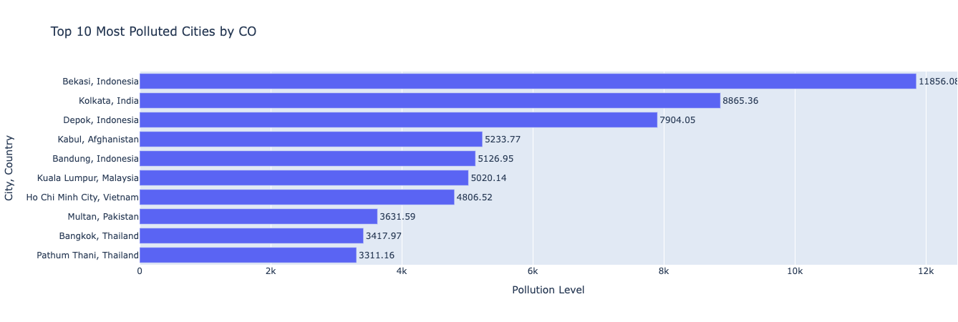
DATA VISUALIZATIONS
INTRO
OVERVIEW
TOP 10 MOST POLLUTED CITIES BY…
KEY FINDINGS
DATA COLLECTION & PROCESSING
Linked to industrial activities and fossil fuel consumption, SO2 is higher in density populated cities with significant industrial activity.
We might be able to draw a regional correlation when assessing the following visualization
China and India being large industrial activity countries
DATA VISUALIZATI-ONS
CORRELATION ANALYSIS
KEY TAKEAWAYS
CONCLUSIONS

Slide 7
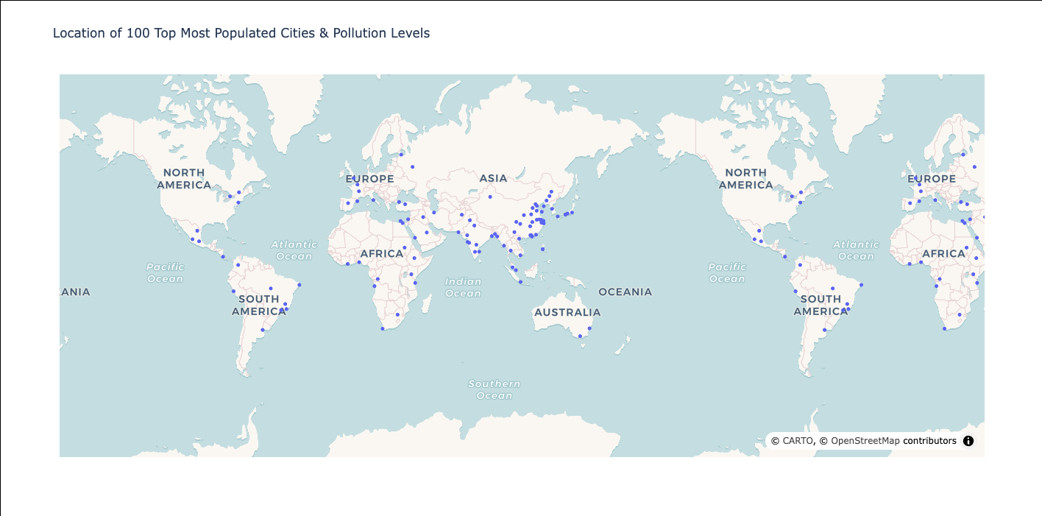
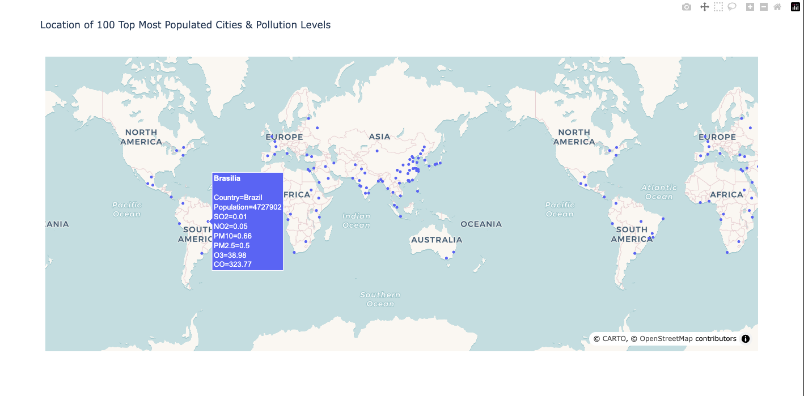
DATA VISUALIZATIONS
INTRO
OVERVIEW
TOP 100 MOST POPULATED CITIES BY…
DATA COLLECTION & PROCESSING
DATA VISUALIZATI-ONS
CORRELATION ANALYSIS
KEY TAKEAWAYS
CONCLUSIONS

Slide 8
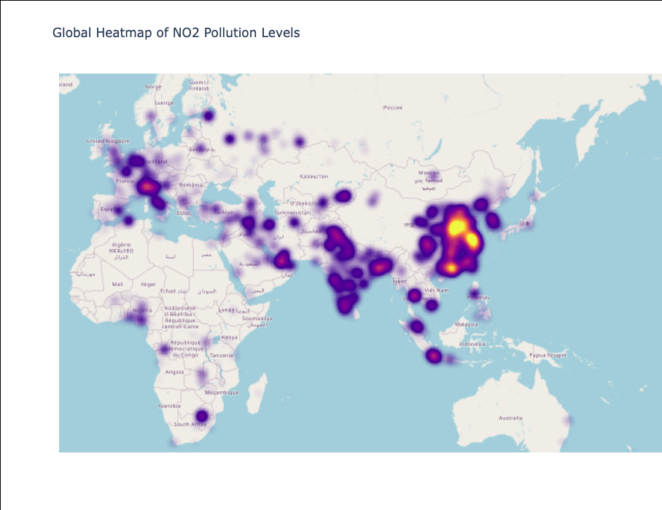
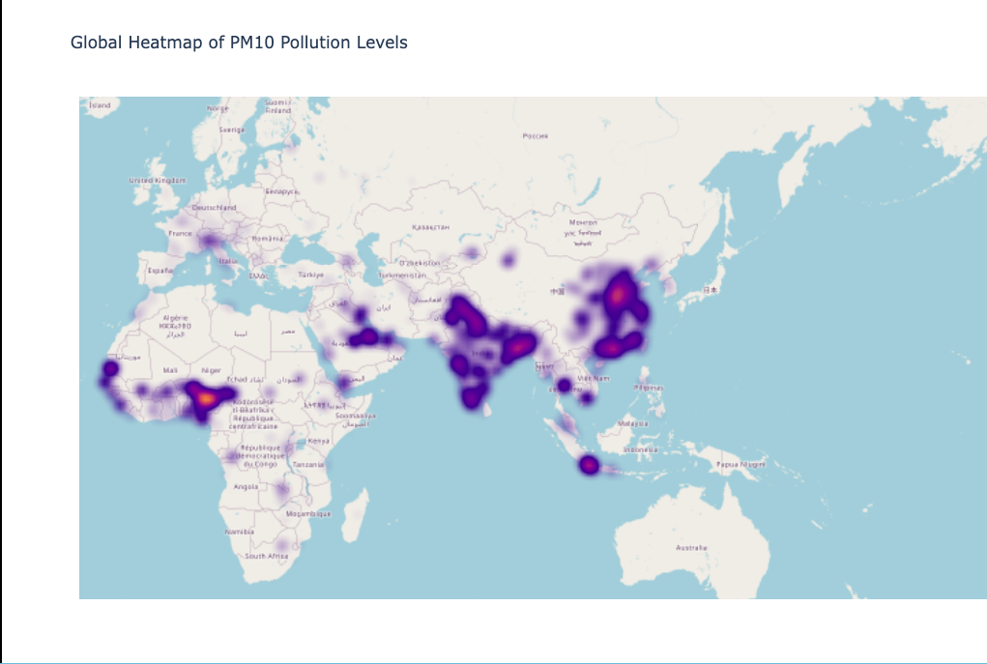
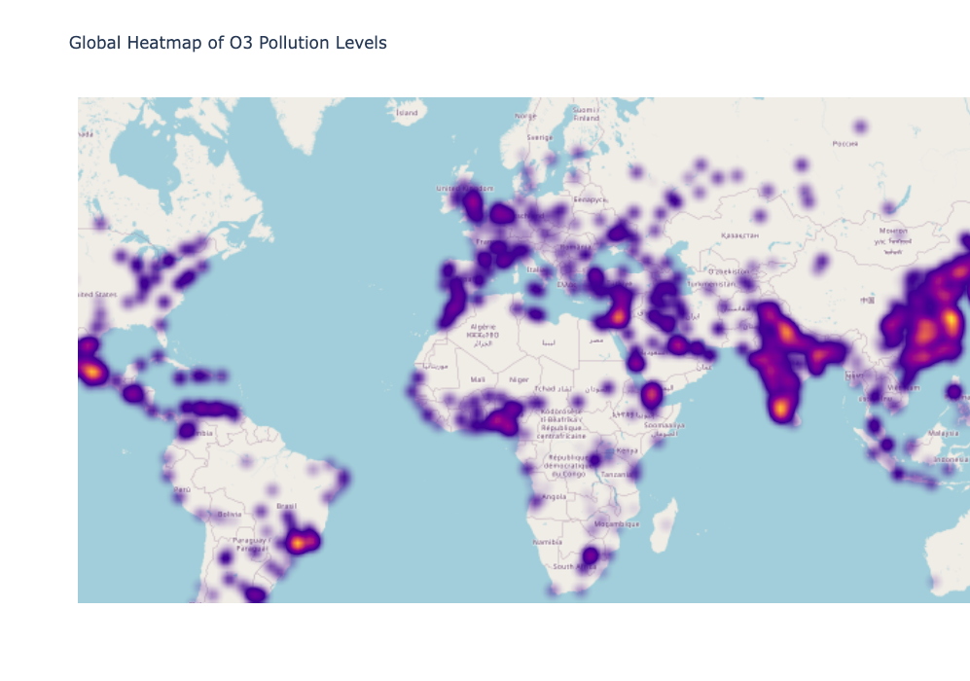
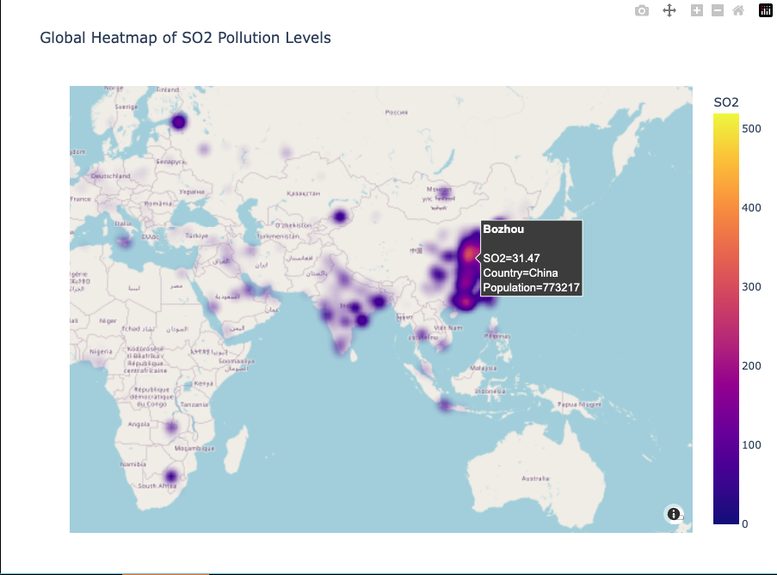
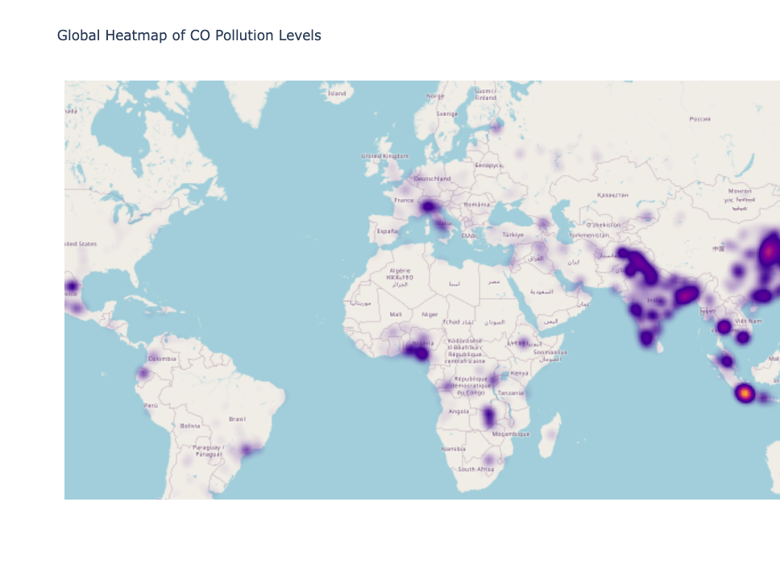
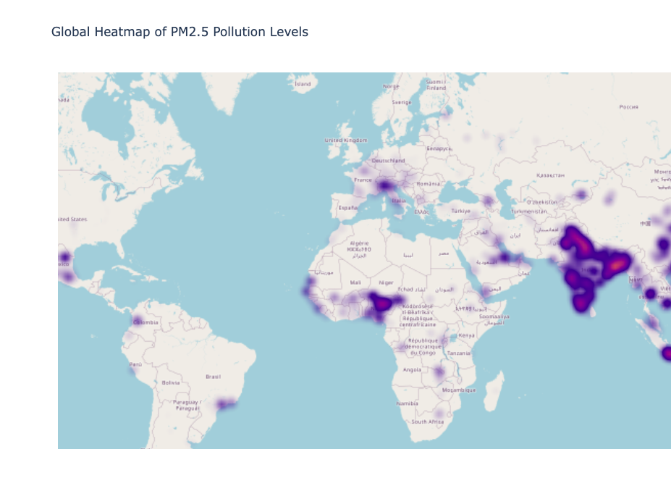
DATA VISUALIZATIONS
INTRO
OVERVIEW
GLOBAL HEATMAP & POLLUTION LEVELS
DATA COLLECTION & PROCESSING
A heatmap gives us further insight into regional patterns and observations:
South Asia (India, Pakistan, Bangladesh): Consistently shows high levels of PM2.5, CO, and NO2, correlating with rapid urbanization, dense populations, and reliance on fossil fuels.
Southeast Asia (Indonesia, Vietnam): Increasing air pollution due to industrialization and transportation emissions.
Africa (Nigeria): Rising pollution levels indicate rapid urban growth without sufficient environmental regulations.
DATA VISUALIZATI-ONS
CORRELATION ANALYSIS
KEY TAKEAWAYS
CONCLUSIONS
Notes:
Diana

Slide 9
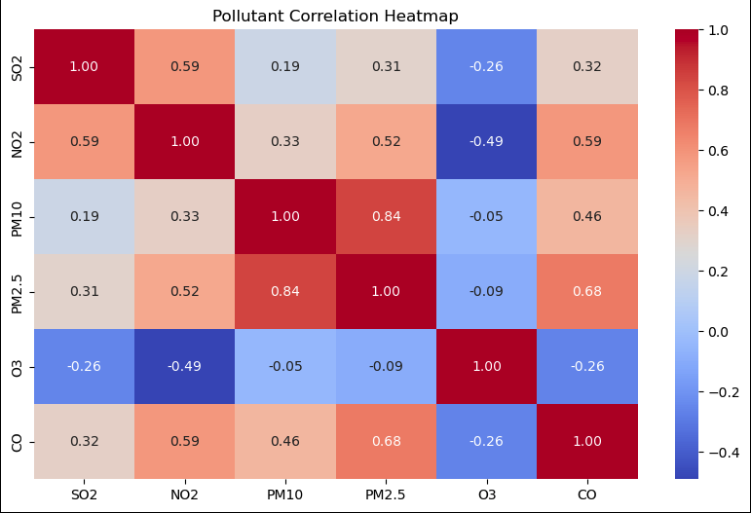
DATA VISUALIZATIONS
INTRO
OVERVIEW
POLLUTANT CORRELATION MATRIX
DATA COLLECTION & PROCESSING
1: Perfect positive correlation (both pollutants behave in the exact same way).
0: No correlation (the two pollutants do not influence each other).
-1: Perfect negative correlation (as one pollutant increases, the other decreases).
The biggest correlation between pollutants exists between PM10 and PM2.5 - both are measures of particulate matter in the air, but they differ in particle size.
Since PM2.5 is a subset of PM10, areas with high PM10 levels often also have high PM2.5 concentrations.
DATA VISUALIZATI-ONS
CORRELATION ANALYSIS
KEY TAKEAWAYS
CONCLUSIONS
Notes:
Anna

Slide 10
KEY FINDINGS
INTRO
OVERVIEW
We went into this project expecting a strong correlation between population growth and increased air pollution.
We found that when it comes to the top 1,000 most populated cities in the world, there is not a strong correlation between the two and think this might have been different had we focused on a much larger data set that included less populated cities. We also could have computed a “total pollution” value based on the average pollution across all 6 observed pollutants and assigned it to each city.
If we were to continue our research and analysis, several topics would prove fruitful in further correlations. These might include:
In conclusion, we have discovered that using the Weather API from OpenWeatherMap is an incredibly powerful beginning for deeper analysis.
DATA COLLECTION & PROCESSING
DATA VISUALIZATI-ONS
Income levels vs Air Pollution
Population Density vs Air Quality
Temperature vs Air Pollution
Humidity vs Particulate Matter
Altitude vs Air Quality
Mortality Rates vs Pollutant Levels
Public Transport Availability vs Air Quality
CORRELATION ANALYSIS
KEY TAKEAWAYS
CONCLUSIONS
Notes:
Diana kicks off

Slide 11
Thank You
Project 1 Group 3
GLOBAL AIR POLLUTION ANALYSIS
An Interactive Data Exploration

